Slide 1

APPLICATION SECURITY
(Threats and Malpractices)
Speaker: Dimitrios Valsamaras | @Ch0pin
https://www.linkedin.com/in/valsamaras/

Slide 2

Common Malpractices
Webviews
Floating Windows
Accessibility Service
Administration API
Reflection
Dynamic Code Loading

Slide 3

Accessibility Service
The accessibility service provides user interface enhancements to assist users with disabilities, or who may temporarily be unable to fully interact with a device. For example, users who are driving, taking care of a young child might need additional or alternative interface feedback.
A powerful set of API calls, used by many popular apps including Google Assistant, Google maps, password managers, app lockers
but also from ….
Trojans, backdoors, bots, phishing apps e.t.c.
? ?

Slide 4
Accessibility Service from a security perspective
An application for which the accessibility service has been granted can run in the background and…
Read the UI of any other application
Parse the entire Android UI to check which layouts are in the screen
Check whether the screen has changed or the screen content has changed
Read notifications coming from/for any application
Perform Clicks / Swipes
Set text to textviews
… Pretty much, it can act in behalf of the user

Slide 5
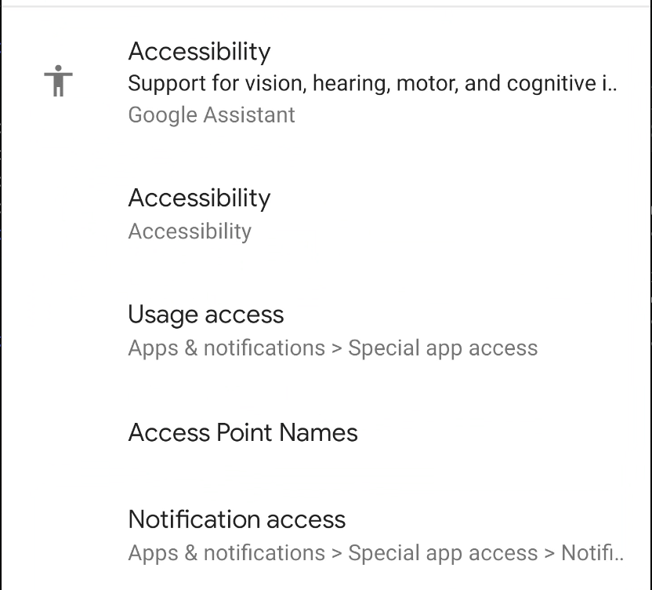
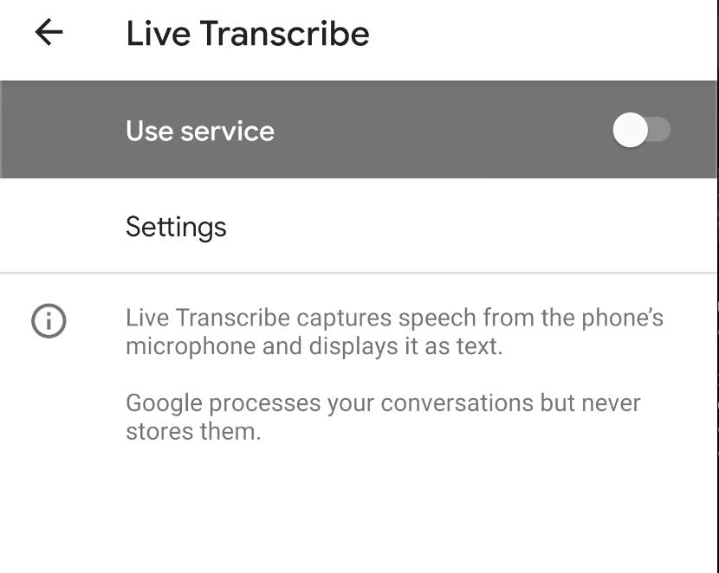
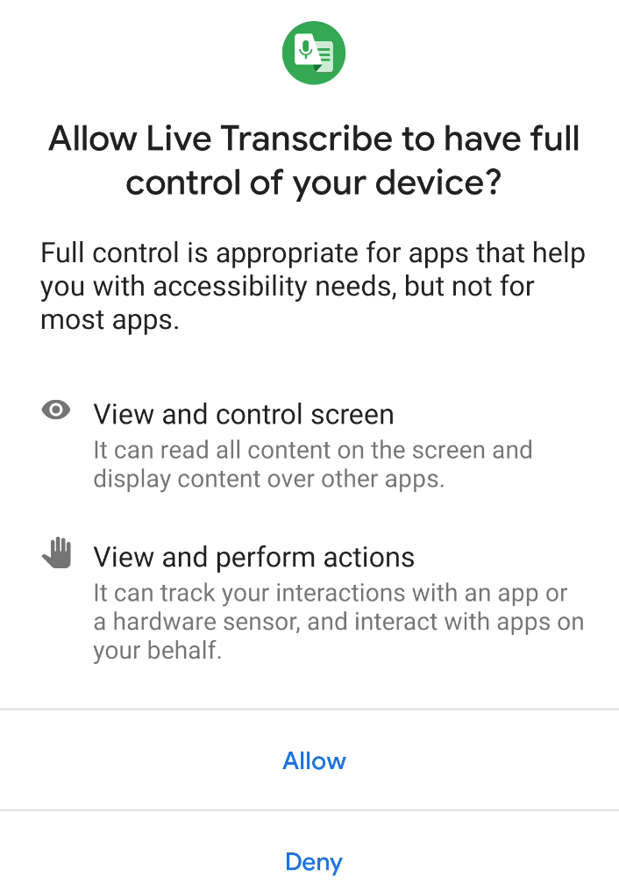
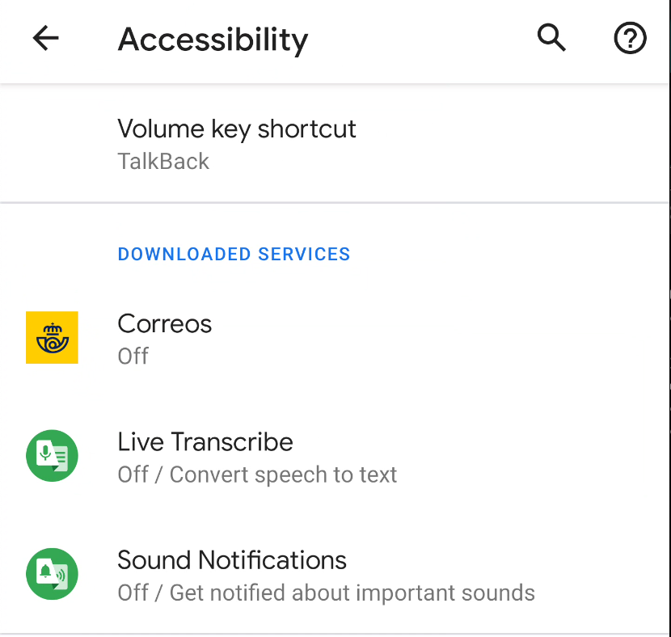
Accessibility Service - How to enable (Android 10)
Settings → Accessibility →
Click on the app →
Use Service→ Allow

Slide 6
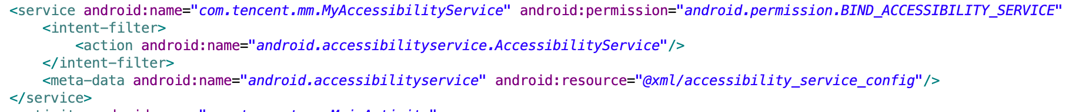
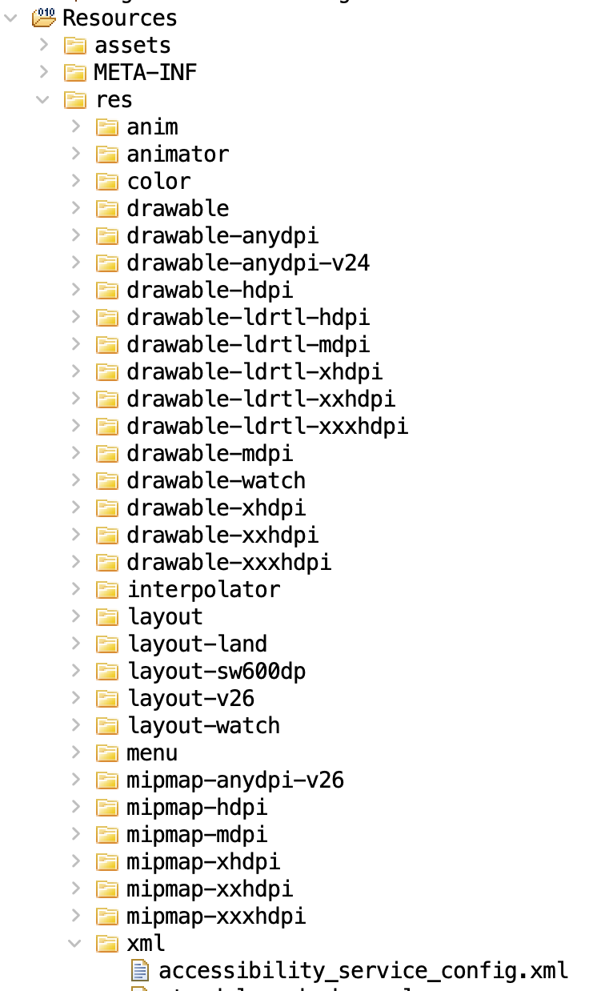
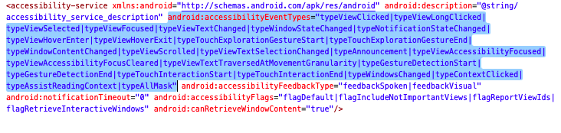
Accessibility Service - Implementation
Implementation Class
Permission
Intent filter
Configuration
AccessibilityService_accessibilityEventTypes: The event types this service would like to receive as specified in AccessibilityEvent. This setting can be changed at runtime by calling

Slide 7
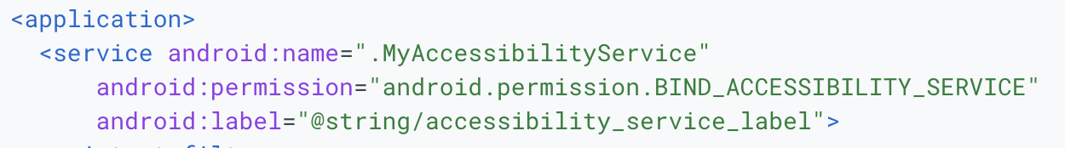
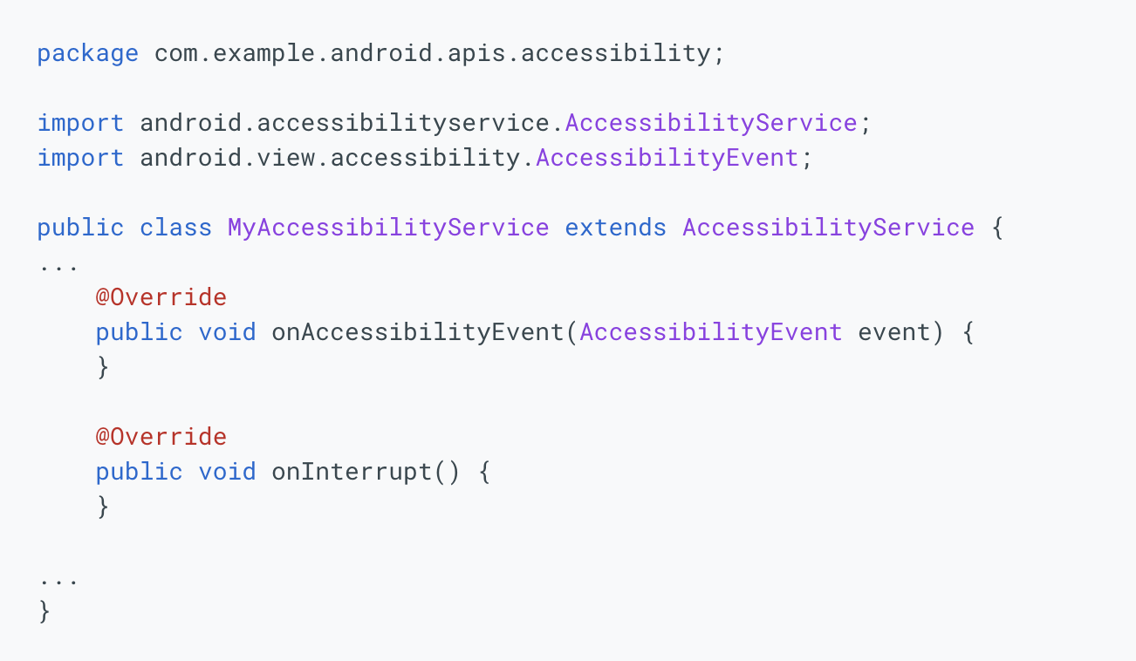
Accessibility Service - Java Code Implementation
Class name declared in the Manifest
Override Required

Slide 8
Accessibility Service - Accessibility Event
An accessibility event is fired by an individual view which populates the event with data for its state and requests from its parent to send the event to interested parties. The parent can optionally modify or even block the event based on its broader understanding of the user interface's context.
The main purpose of an accessibility event is to communicate changes in the UI to an AccessibilityService.
The service may inspect, if needed the user interface by examining the View hierarchy, as represented by a tree of AccessibilityNodeInfo (snapshot of a View state) which can be used for exploring the window content.

Slide 9
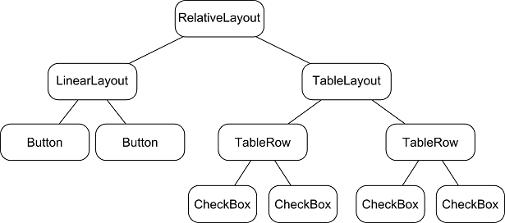
Accessibility Service - View Hierarchy Example
Figure by: https://stackoverflow.com/questions/18004148/android-what-is-view-hierarchy

Slide 10
Accessibility Service - Event Lifecycle
UI changed
Accessibility Event
No
Yes
Trigger Callback
Ignore
Match ?

Slide 11
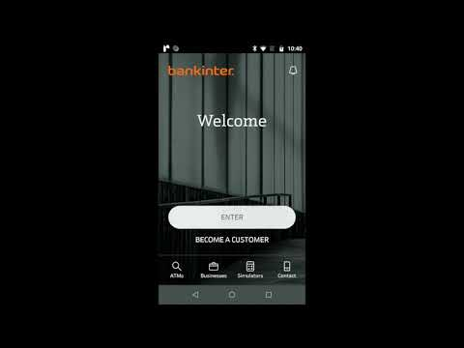
Accessibility Service - Abuse
Flutbot Abuses the accessibility service to get the foreground app.
If the application is in its target list, it will trigger an overlay which will cover the legitimate application with a fake one
After getting the credentials inserted to the fake view, it sends them to a Command and Control server
Video by: https://www.threatmark.com/flubot-banking-malware/

Slide 12
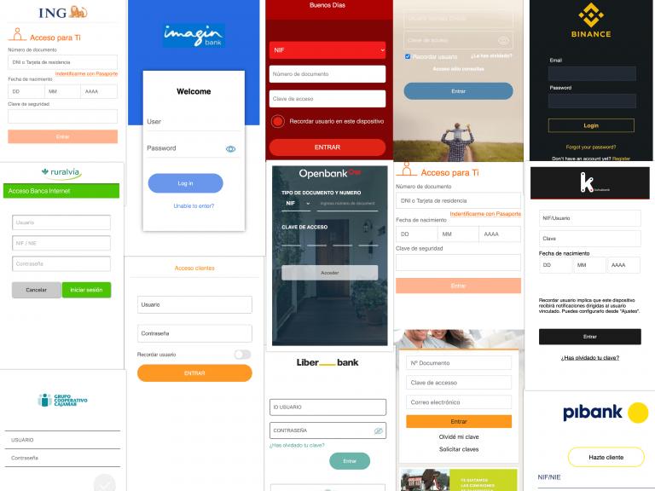
Accessibility Service - Abuse
Overlays targeting legitimate applications
Figure by: https://www.threatmark.com/flubot-banking-malware/

Slide 13

Accessibility Service - Abuse, Overlays
Monitoring the API calls performed by the accessibility service implementation.

Slide 14
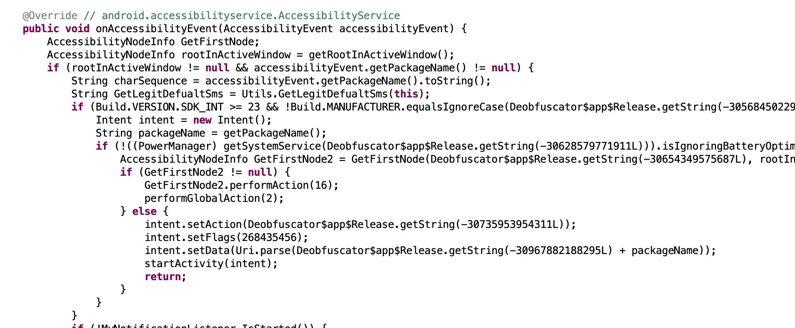
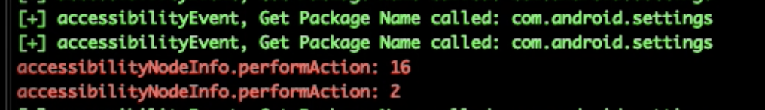
Accessibility Service - Abuse
Click
Home

Slide 15
Accessibility Service - Abuse
log typed keys (keyloggers)
auto-enable permissions
auto-enable access to services
When correctly coordinated it can perform chain of actions to automate more complex tasks (e.g. screen recording)

Slide 16
Common Malpractices
Webviews
Floating Windows
Accessibility Service
Administration API
Reflection
Dynamic Code Loading

Slide 17
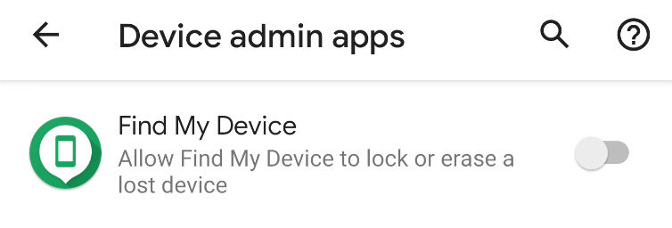
Device Admin
Definition: The Device Administration API provides device administration features at the system level. These APIs allow you to create security-aware apps that are useful in enterprise settings, in which IT professionals require rich control over employee devices.

Slide 18
Device Admin
Set password quality.
Specify requirements for the user's password, such as minimum length, the minimum number of numeric characters it must contain, and so on.
Set the password. If the password does not conform to the specified policies, the system returns an error.
Set how many failed password attempts can occur before the device is wiped (that is, restored to factory settings).
Set how long from now the password will expire.
Set the password history length (length refers to number of old passwords stored in the history). This prevents users from reusing one of the last n passwords they previously used.
Specify that the storage area should be encrypted, if the device supports it.
Set the maximum amount of inactive time that can elapse before the device locks.
Make the device lock immediately.
Wipe the device's data (that is, restore factory settings).
Disable the camera.

Slide 19
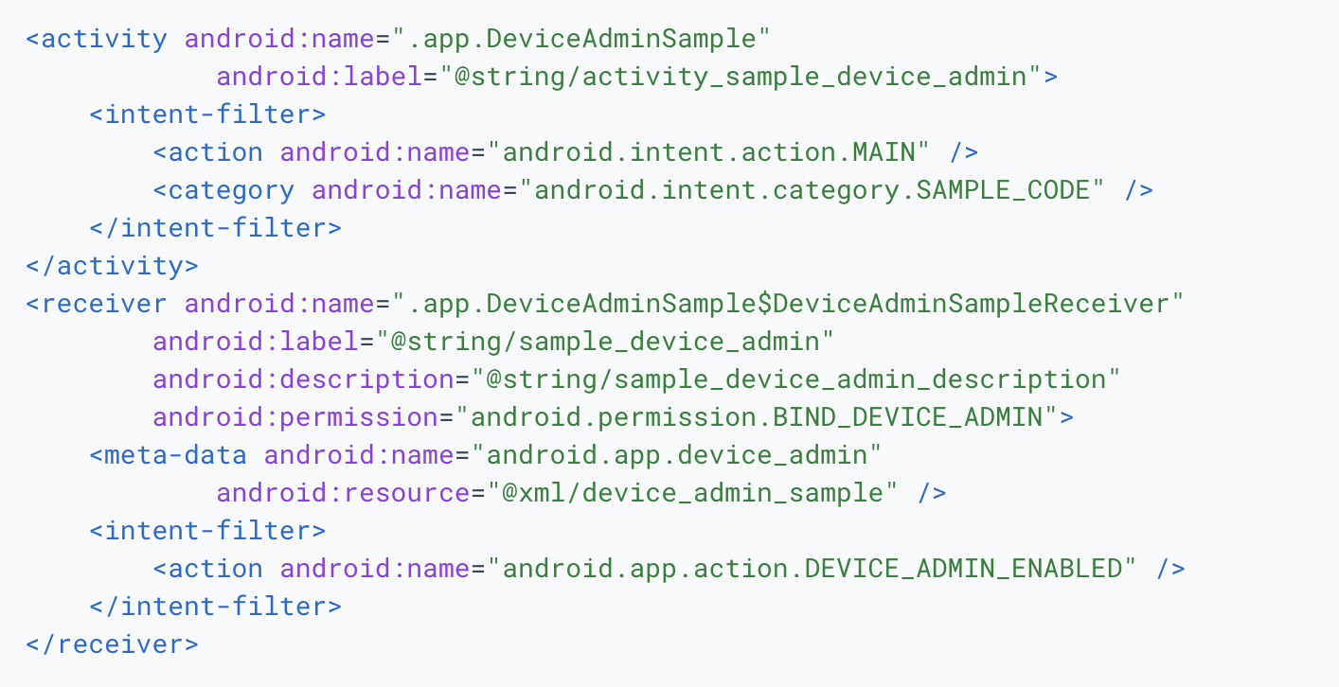
Device Admin - Implementation
DeviceAdminReceiver subclass
Permission
Filter

Slide 20
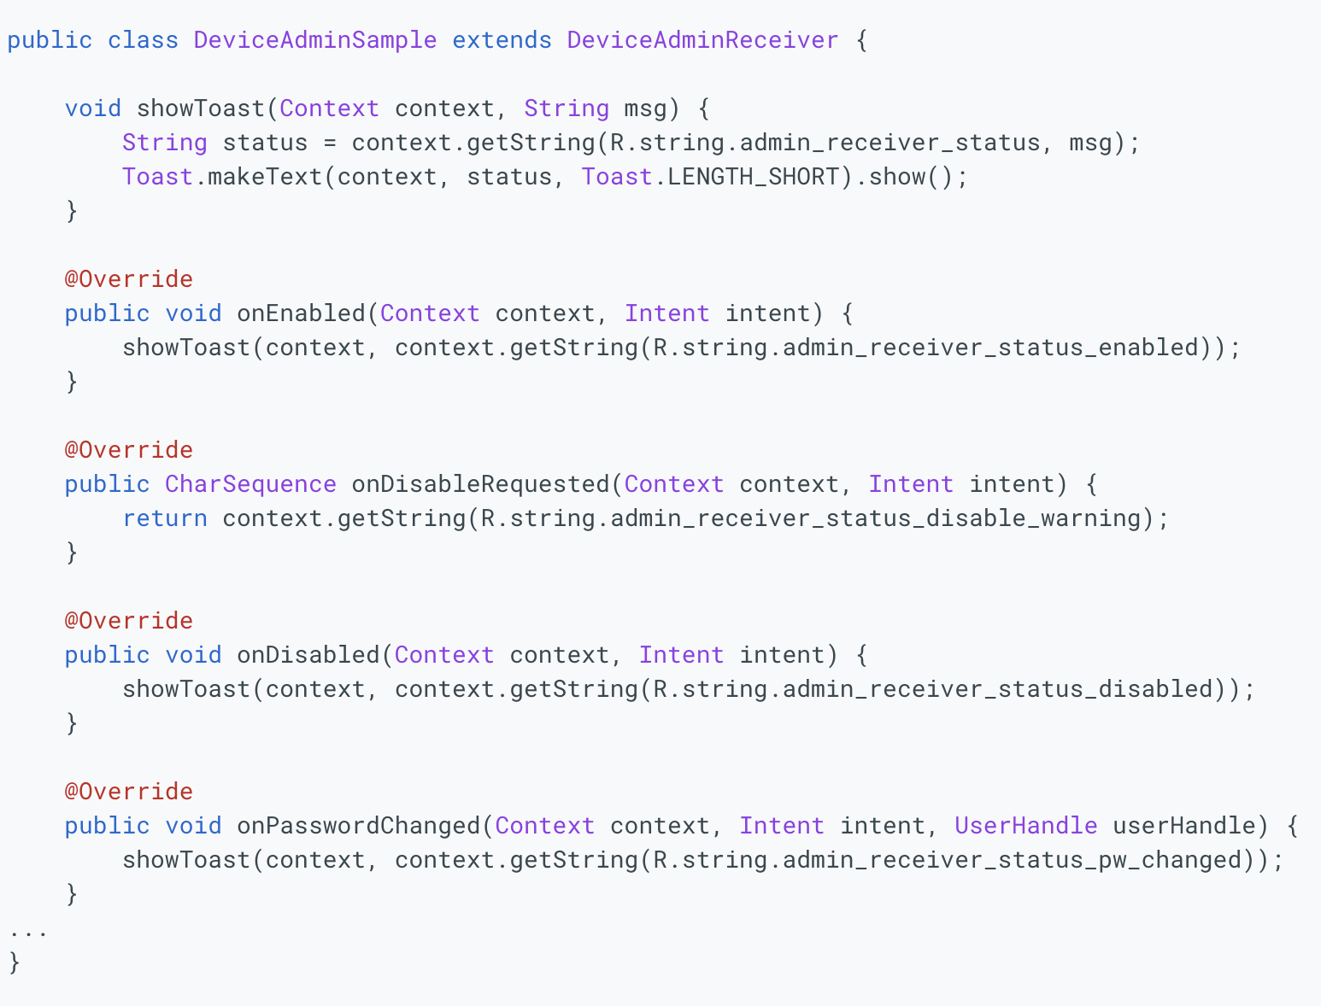
Device Admin - Callbacks
Permission

Slide 21
Common Malpractices
Webviews
Floating Windows
Accessibility Service
Administration API
Reflection
Dynamic Code Loading

Slide 22

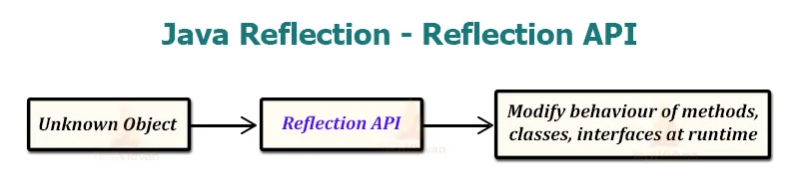
Java Reflection
Reflection is commonly used by programs which require the ability to examine or modify the runtime behavior of applications running in the Java virtual machine. This is a relatively advanced feature and should be used only by developers who have a strong grasp of the fundamentals of the language. With that caveat in mind, reflection is a powerful technique and can enable applications to perform operations which would otherwise be impossible.
Figure from: https://techvidvan.com/tutorials/reflection-in-java/

Slide 23
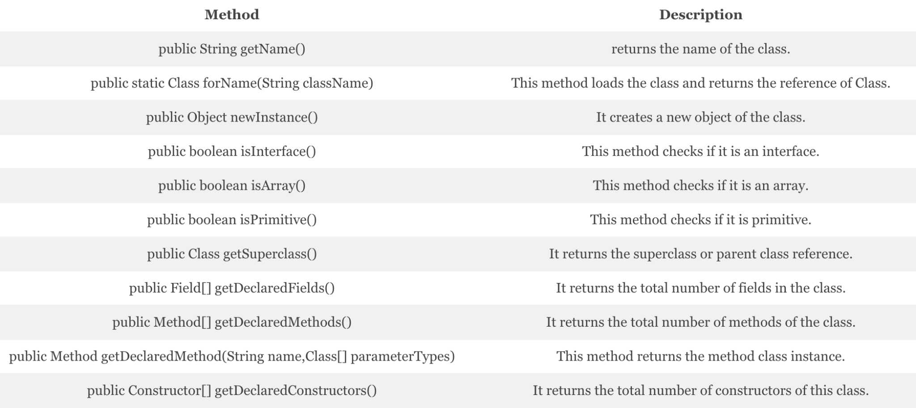
Java Reflection
url: https://techvidvan.com/tutorials/reflection-in-java/

Slide 24
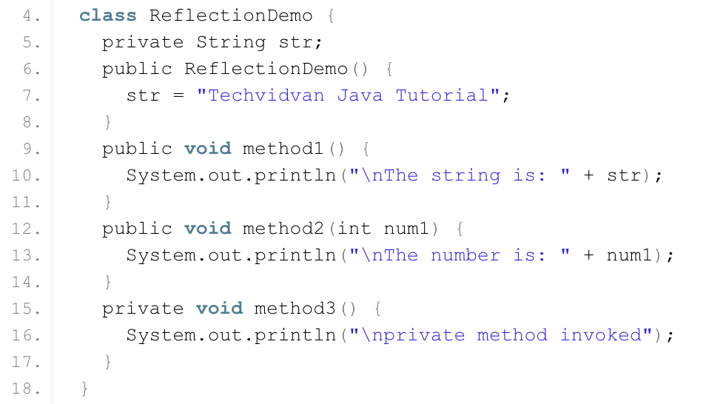
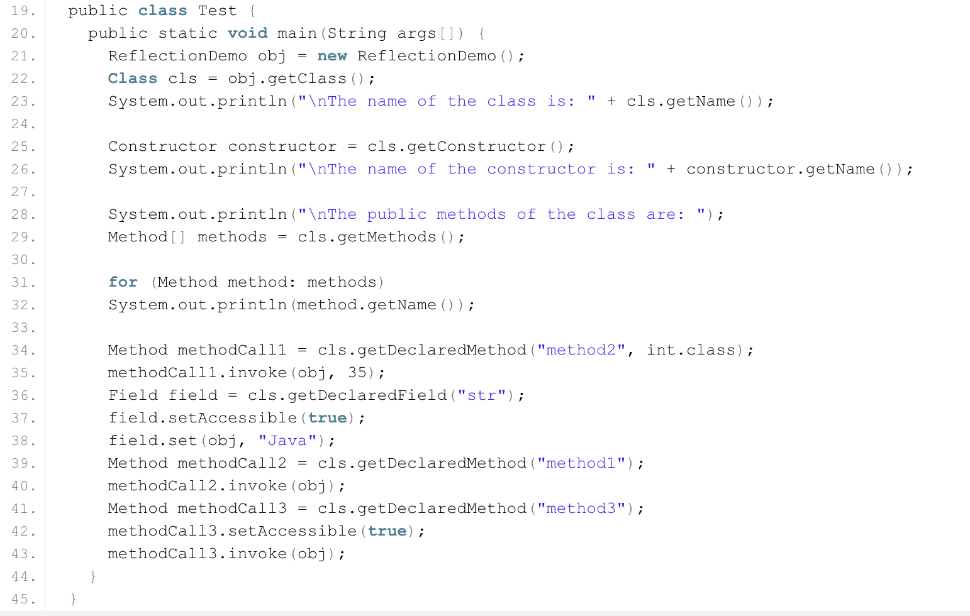
Java Reflection
The Test class users reflection to get the ReflectionDemo class characteristics and invoke its defined methods.
https://techvidvan.com/tutorials/reflection-in-java/

Slide 25
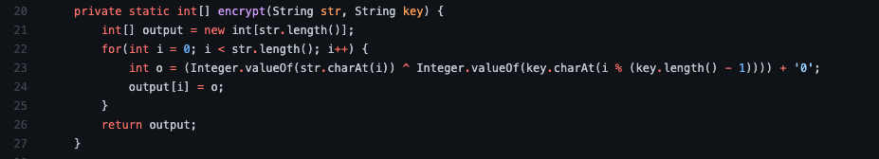
Java Reflection - Misuse
Can be used to “hide” suspicious API calls
Example: “java.lang.Runtime” , “1”
Return
[PGP.]P_V.cD_EX\T
Class cls = Class.forName(decrypt(“[PGP.]P_V.cD_EX\T”));

Slide 26
Common Malpractices
Webviews
Floating Windows
Accessibility Service
Administration API
Reflection
Dynamic Code Loading

Slide 27

Dynamic Code Loading - DCL
DCL(Dynamic code loading) allows an application to load code that is not part of its static, initial codebase. The additional code can be retrieved from a remote location and executed at runtime.
Code Reuse
Extensibility
Self-upgrade

Slide 28
Dynamic Code Loading - Implementation
DexClassLoader(String dexPath, String optimizedDirectory, String librarySearchPath, ClassLoader parent)
dexPath | String: the list of jar/apk files containing classes and resources, delimited by File.pathSeparator, which defaults to ":" on Android
optimizedDirectory | String: this parameter is deprecated and has no effect since API level 26.
librarySearchPath | String: the list of directories containing native libraries, delimited by File.pathSeparator; may be null
parent | ClassLoader: the parent class loader

Slide 29
Dynamic Code Loading - Implementation
Fetch the dex, jar, apk e.t.c
DexClassLoader(String dexPath, String optimizedDirectory, String librarySearchPath, ClassLoader parent)
String dexPath = context.getFilesDir().getAbsolutePath() + “/” +"dexPath.dex";
Final DexClassLoader nClazz = new DexClassLoader(dexPath,mContext.getCodeCacheDir().getAbsolutePath(), null,getClass().getClassLoader()).loadClass(clazz);

Slide 30
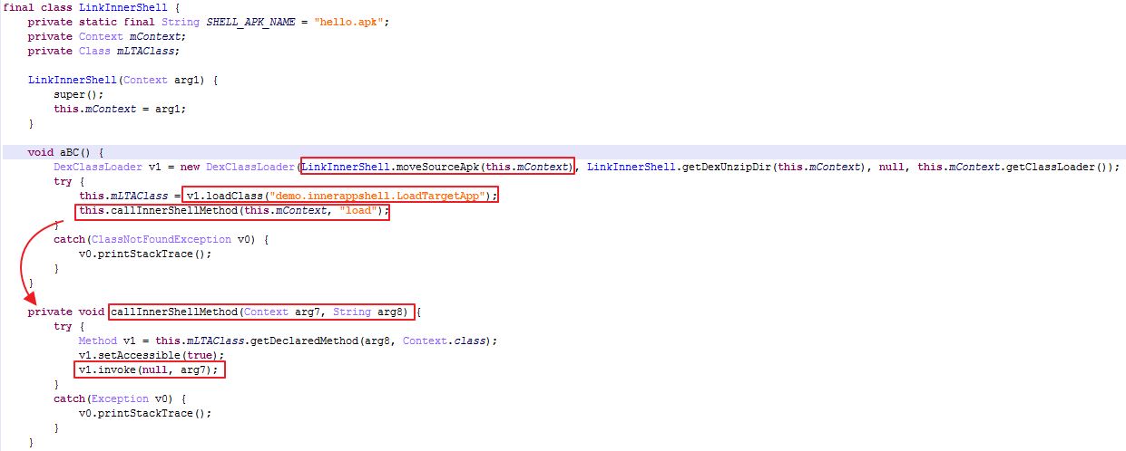
Dynamic Code Loading - what is wrong with this ?
https://www.fortinet.com/blog/threat-research/unmasking-android-malware-a-deep-dive-into-a-new-rootnik-variant-part-ii

Slide 31
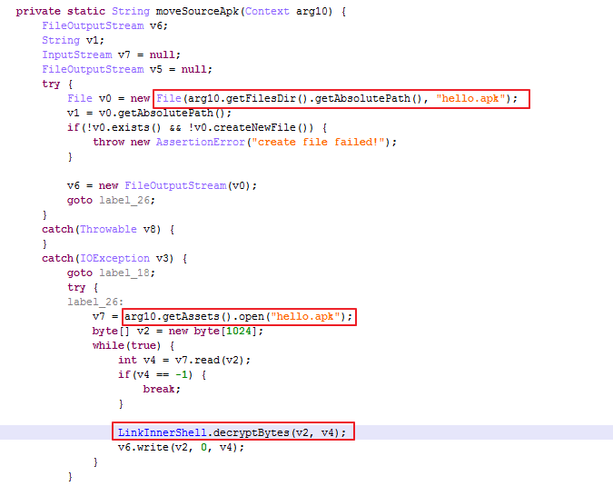
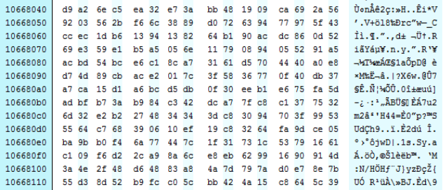
Dynamic Code Loading - what is wrong with this ?
Name can be encrypted
Content can be encrypted
https://www.fortinet.com/blog/threat-research/unmasking-android-malware-a-deep-dive-into-a-new-rootnik-variant-part-ii

Slide 32
References
https://developer.android.com/guide/topics/ui/accessibility/service
https://www.javatpoint.com/java-reflection
https://kalpeshchandora12.medium.com/dynamic-code-loading-in-android-dea83ba3bc85

